Slide 1
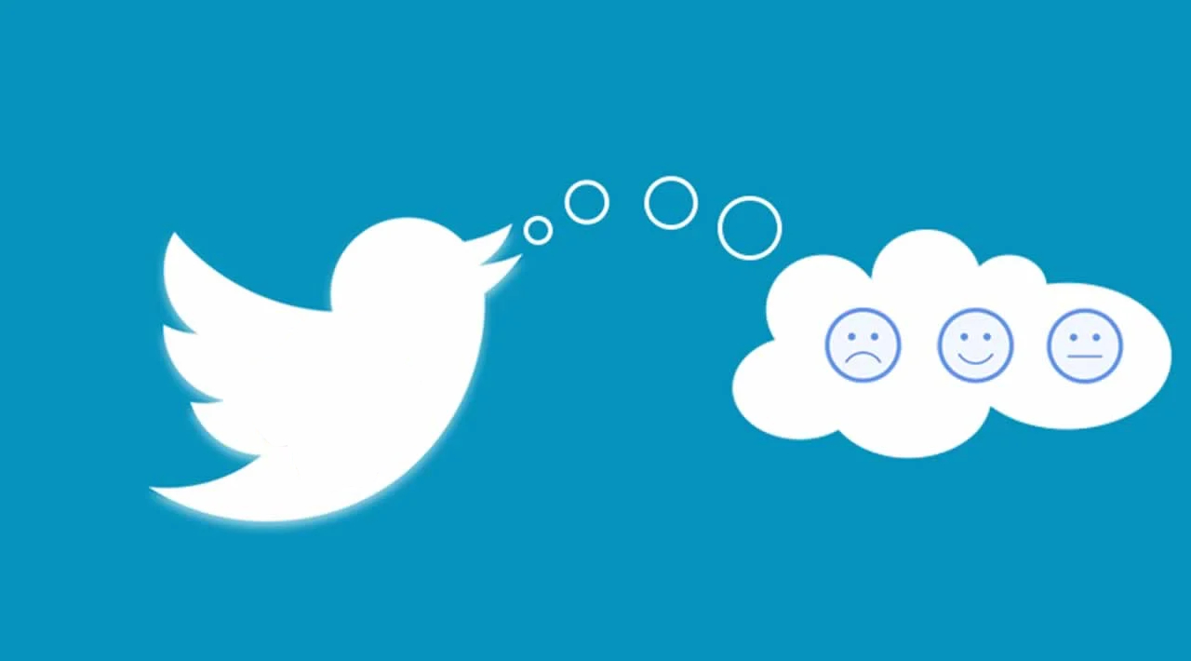
Twitter Data Sentiment Analysis
- By Rushikesh Pawar.

Slide 2
Table of Content
Introduction
Problem Statement
Objective
Data Pre-processing
Sentimental Analysis
Prediction
Conclusion
Business Insights

Slide 3




Introduction
Each tweet is 140 characters in length.
Tweets are frequently used to express a tweeter semotion on a particular subject.
Sentiment Analysis is a task of identifying whether the opinion expressed in a text is positive or negative.
Automatically extracting opinions, emotions, and sentiments in text.
It is language-independent technology that understand.
It identifies the opinion or attitude that a person has towards a topic or an object.

Slide 4
What is Sentiment Analysis?
It is a classification of the polarity of a given text in the document, sentence, or phrase
The goal is to determine whether the expressed opinion in the text is positive, negative, or neutral.

Slide 5
Problem Statement
Given a message, decide whether the message is of positive, negative, or neutral sentiment. For messages conveying both a positive and negative sentiment, whichever is the stronger sentiment should be chosen.

Slide 6



Challenges
Tweets are highly unstructured and also non-grammatical
Out of Vocabulary Words
Lexical Variation
Extensive usage of acronyms like asap, lol, and afaik

Slide 7
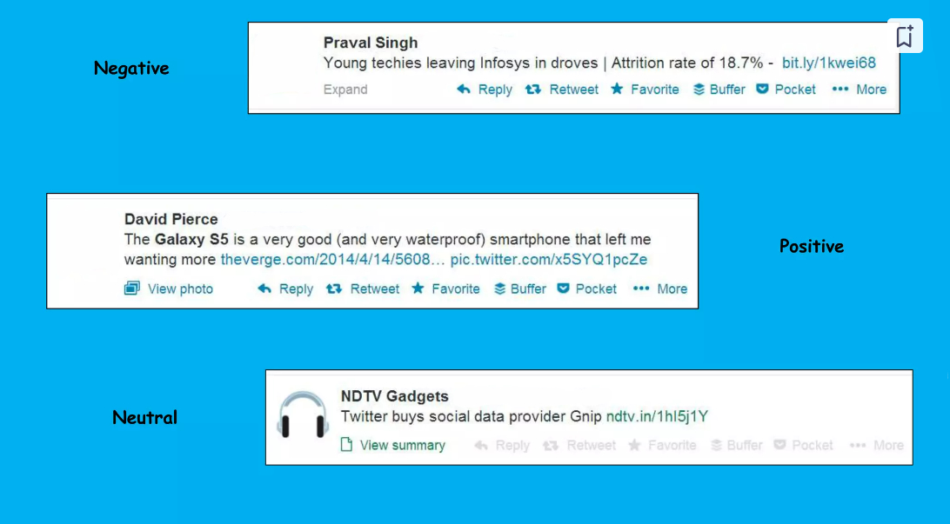

Slide 8








Planning of Project
(After setting goal we have done study regarding domain and gone through research paper)
Feasibility Study
(We checked for requirement that need for project)
Requirement Analysis
Project Implementation
(Here we write the code and build and apply models)
Project Finalization
(We set our goal and checked that our idea is helpful to business and can it be deployed)
Architecture Design
(After research we made architecture design.)
Flow Discussion
(Here we decided time for each module and work for each individual)
Documentation
(For submission we have created report and published 2 research paper)

Slide 9
Objective
The main objective of the project is to predict weather the tweets are positive or negative.

Slide 10




Work Flow
04
04
Data Collection
We have collected data from Kaggle repository.
2. Data Cleaning & Visualization
We removed words, punctions and url
that were not required.
3. Model Building
We build NLP model & applied
sentiment analysis.
4. Prediction
We successfully get the most
used word and sentiment behind tweet
03
03
02
02
01
01

Slide 11
01
Jupyter Notebook
02
Python
Tools and Platform Used
03
NLP
04
NLTK Library
05
WordCloud

Slide 12
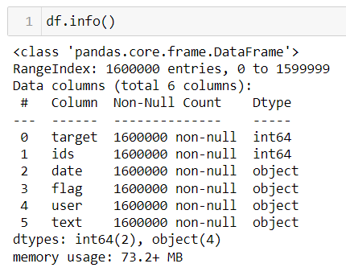
Data Description
Data has 1600000 rows and 2 columns.
Data is in text format so this is a Deep Learning task.

Slide 13
Data Pre-processing
Convert to lower case
Remove link and url
Remove all punctions
Convert wort to root word
Remove common words and white spaces
Remove all words that do not contribute to the meaning of sentence.
Either Remove Numbers or convert it to text format.

Slide 14
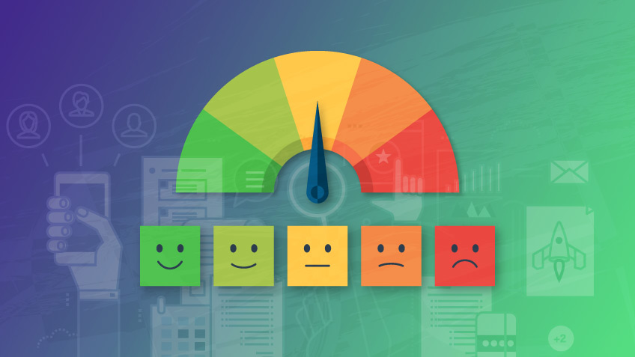
Advantage and Future Scope
Sentiment analysis helps to improve customer service.
Depending upon review it helps to develop quality products.
Sentiment analysis can be used to understand the behavior of customers or the public to get more insights, to make strategies, and to take action.

Slide 15
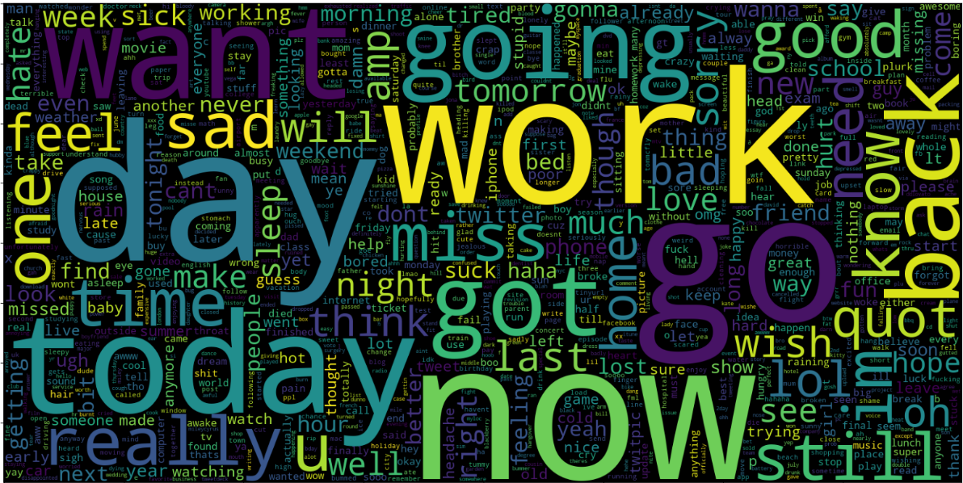
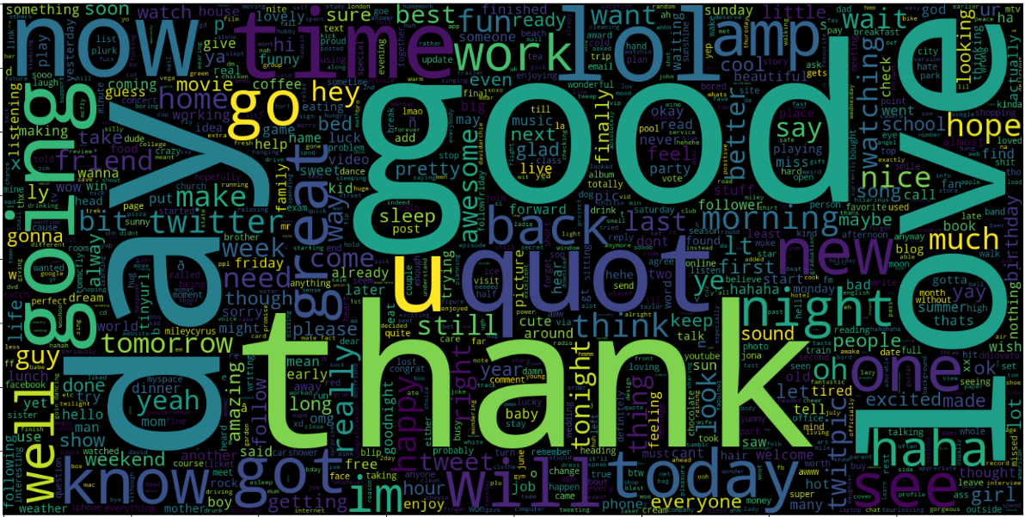
Prediction
Here we get the most frequently used word in Positive tweets & Negative tweets.

Slide 16
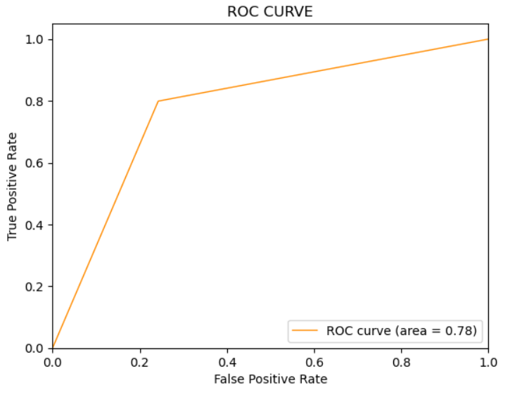
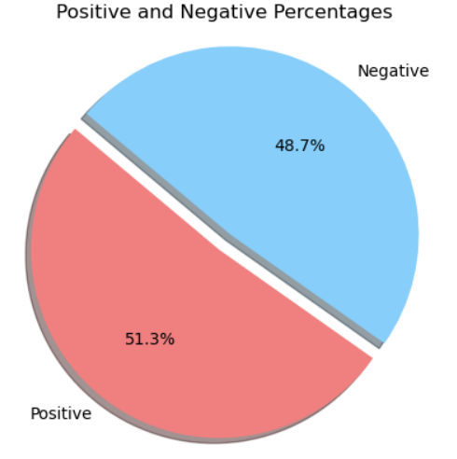
Prediction
51.3 % positive sentiments in data and the Area under ROC Curve is 78%

Slide 17
Conclusion
As we can see after trying out all the methods, we came up with 78% accuracy.
We hope through this article, you got a basic of how Sentimental Analysis is used to understand public emotions behind people’s tweets. As you’ve read in this article, Twitter Sentimental Analysis helps us preprocess the data (tweets) using different methods and feed it into Different models to give the best accuracy
From this project I got the chance to practically implement the NLP technique on data and do the sentiment analysis of the same.
Twitter Sentimental Analysis is used to identify as well as classify the sentiments that are expressed in the text source.
Logistic Regression and Naive Bayes are some of the ML algorithms that can be used for Twitter Sentimental Analysis.

Slide 18
Business Insights
Twitter sentiment analysis can help businesses understand how consumers view their brand. It uses text analysis and natural language processing to identify and classify the emotions expressed in a tweet. This analysis can help businesses

Slide 19
Thank You!

